Slide 1
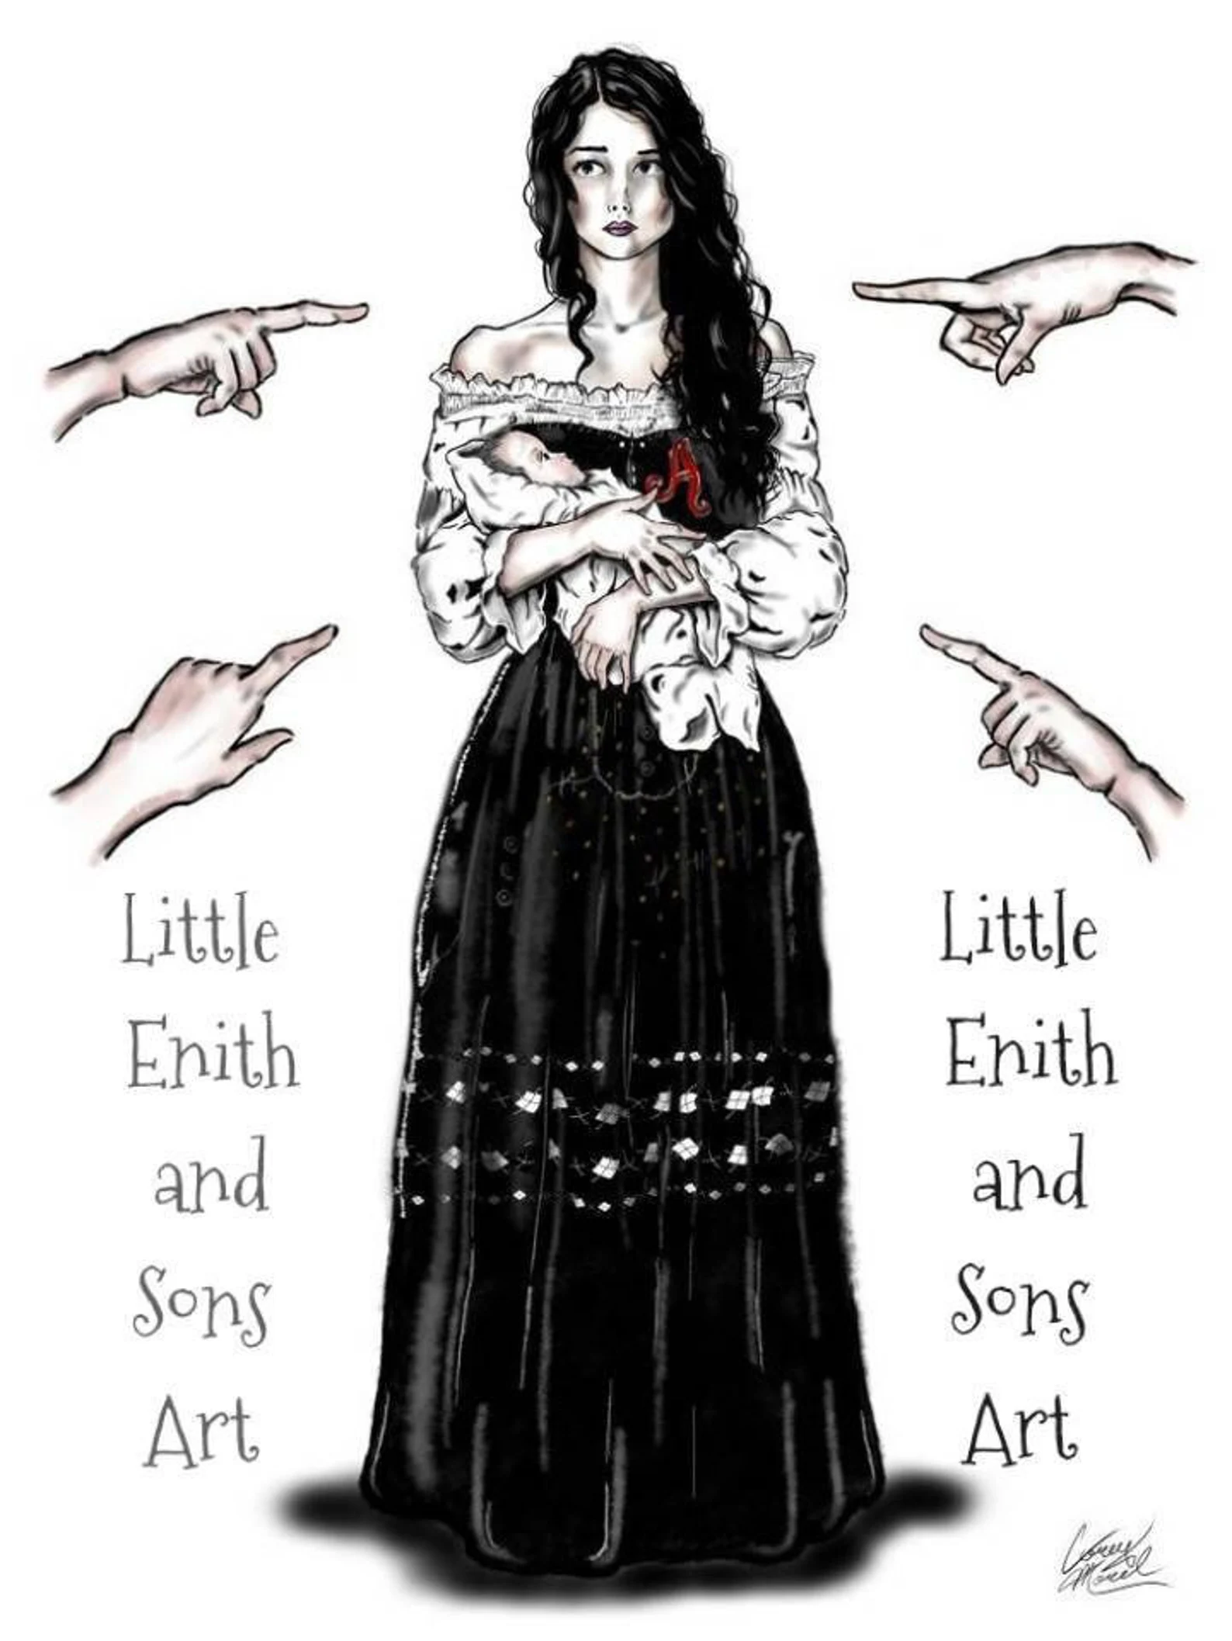
The Scarlet Letter: A socio psychological analysis
Presented by
Tinny Rani Nath (2020236022)

Slide 2

The impact of public shaming on mental health
Isolation
Emotional struggle
Guilt
Psychological effects
Inner strength

Slide 3
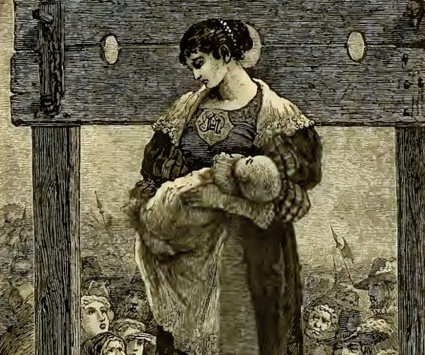
Psychological Dimensions in The Scarlet Letter
Tinny Rani Nath
Department of English
2020236022

Slide 4
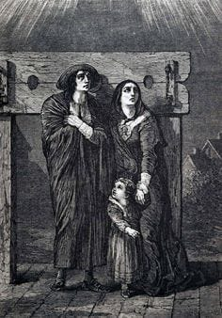
Guilt and internal conflict
Revenge and obsession
Identity and Isolation

Slide 5
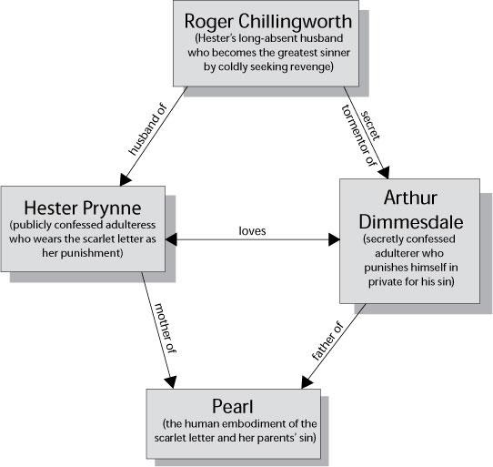

Slide 6

What is my opinion?

Slide 7
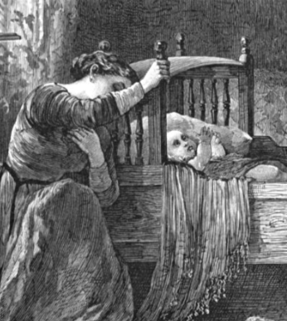
Moral Ambiguity in The Scarlet Letter

Slide 8
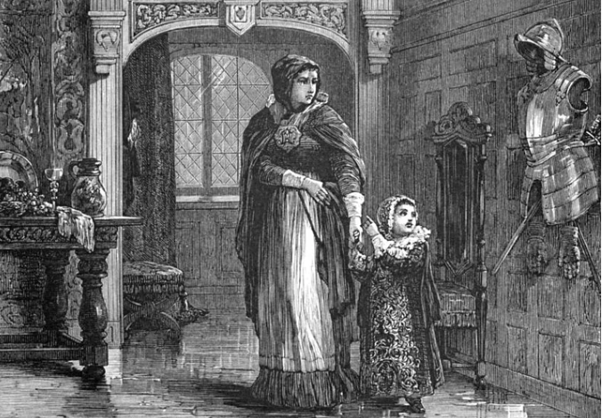
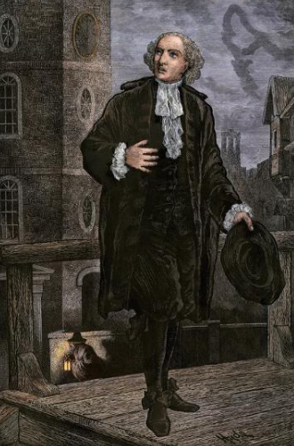
Symbol of Sin and Strength
Hester Prynne
Conflicted Emotions
Moral Complexity
Moral Ambiguity in The Scarlet Letter
Dual Identity
Aurthur Dimmensdale
Inner Conflict
Path to Redemption

Slide 9
Symbolism in ‘The Scarlet Letter’
The scarlet letter “A” : sin of adultery.
Pearl: Sort of living version.
The Forest: represent freedom and free from societal norms.
Light and Darkness: light symbolizes hope and Darkness represents sin.

Slide 10
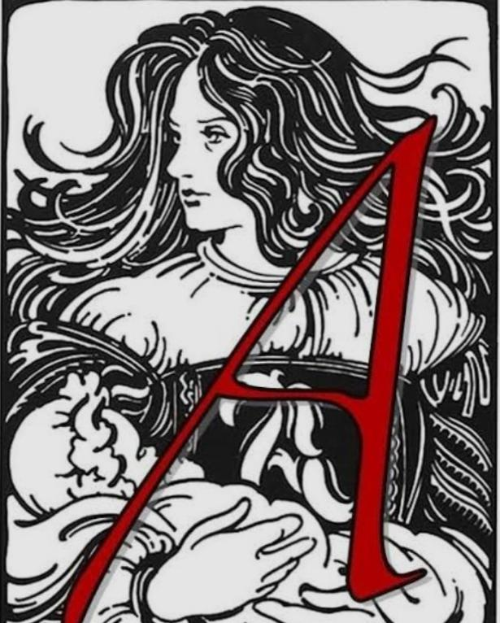
“A” is the literal symbol of the sin of adultery . To Hester A means humiliation. The A to Dimmesdale is a reminder of his own contrition. To Pearl A is a peculiarity. Rozer chillingworth sees A as a journey for retaliation.

Slide 11
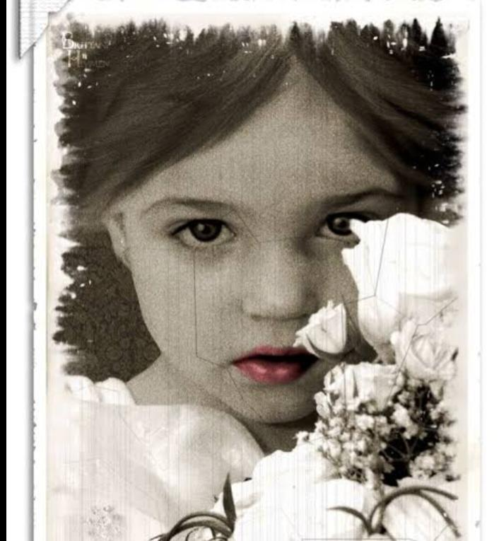
Pearl is a sort of living version of her mothers scarlet letter She represents not only sign but alsovital spirit and passion that endangered that sign. She Functions in a symbolic capacity as the reminder of an unsolved mystery.

Slide 12

The forest is a very symbolic place. Forest is the place where darkness and gloom conquers. In the forest Pearl can run and play and Hester can let her hair down without frowning upon them.

Slide 13
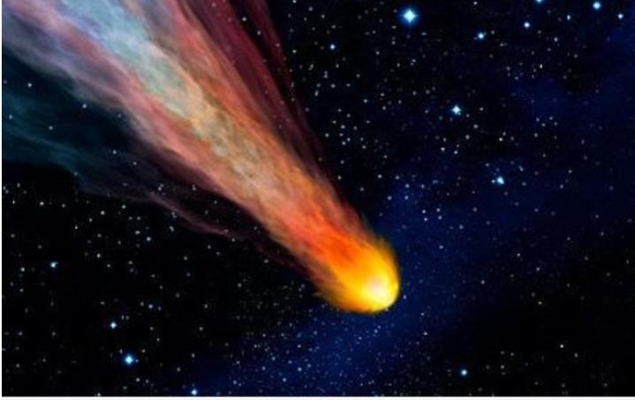
Light and Darkness Light symbolizes truth, hope, and exposure. Darkness represents sin, secrecy, and the unknown.

Slide 14
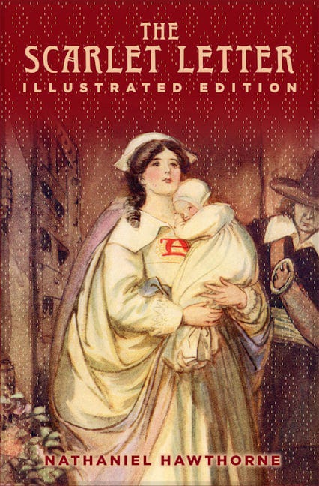

Slide 15
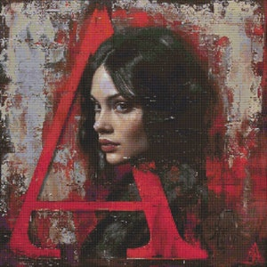

“The Scarlet Letter with modern notions of shame”

Slide 16

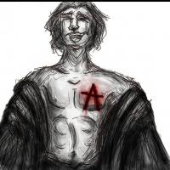
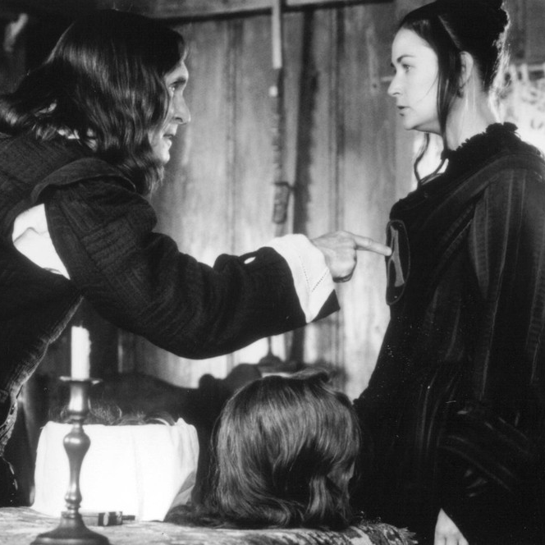
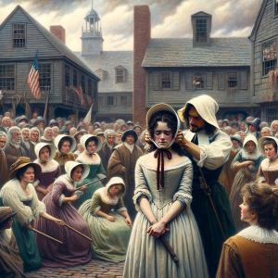
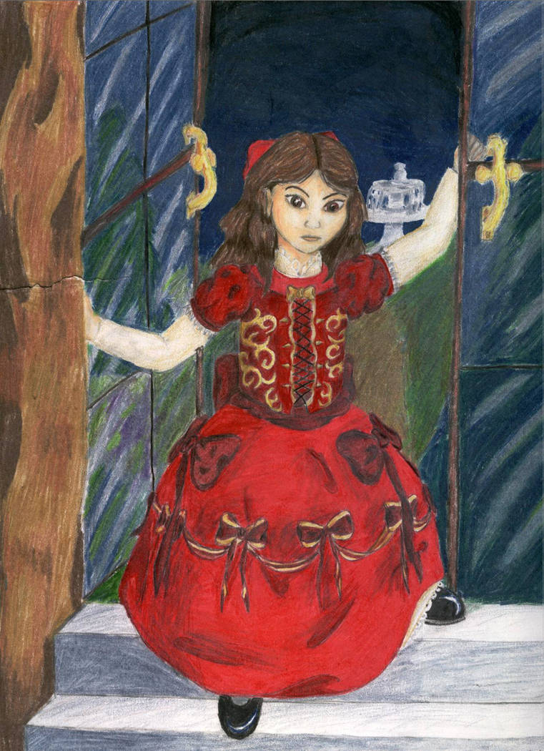
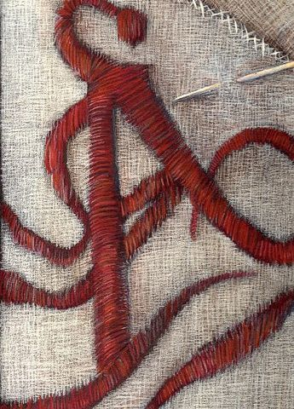
Shame in The Scarlet Letter
Public Shame
Private Shame
Shame represses to crave for revenge
Symbolic Representation of Shame
Role of society
Pearls social isolation

Slide 17
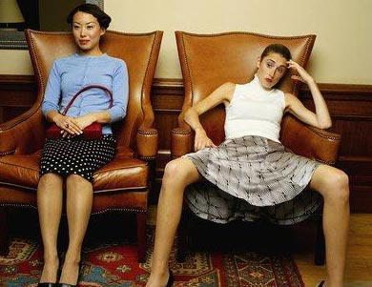


Modern Notions of Shame
Stigma Around Identity
Mark of Societal Judgment
Social Media
And public shaming

Slide 18


Intensity of social media Shaming
It had been assumed that the boy killed his mother and kept her body in refrigerator which was a conspiracy. However , that conspiracy causes the boy a shameful and traumatize situation,
.

Slide 19
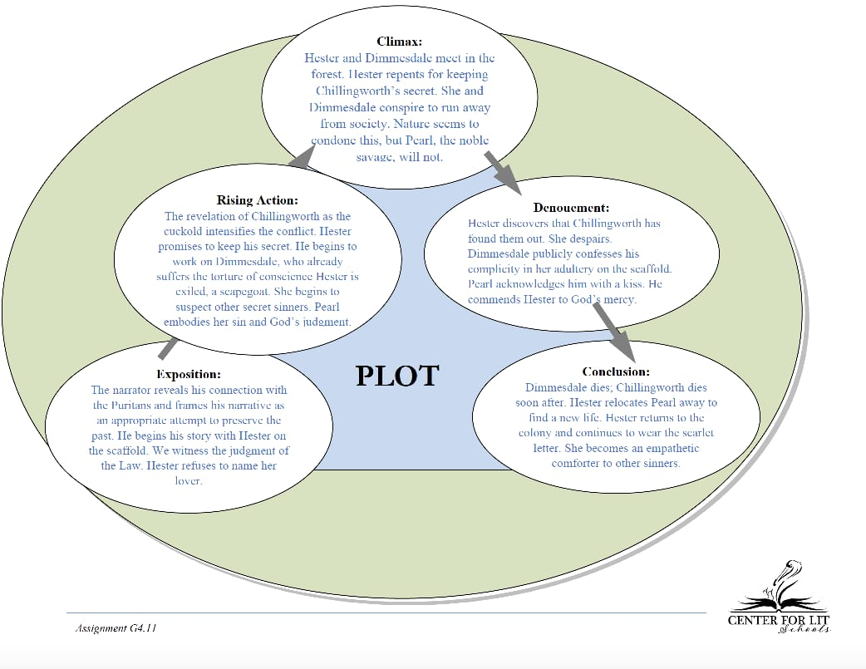

Slide 20
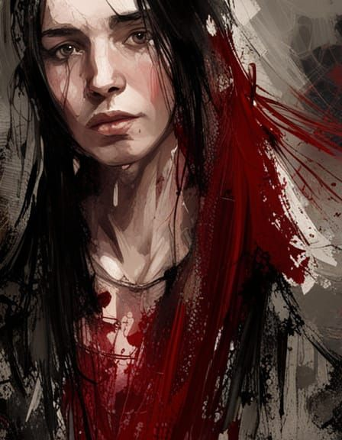
Thank you!
Song Title
Artist
Do you have any questions?

